Slide 1
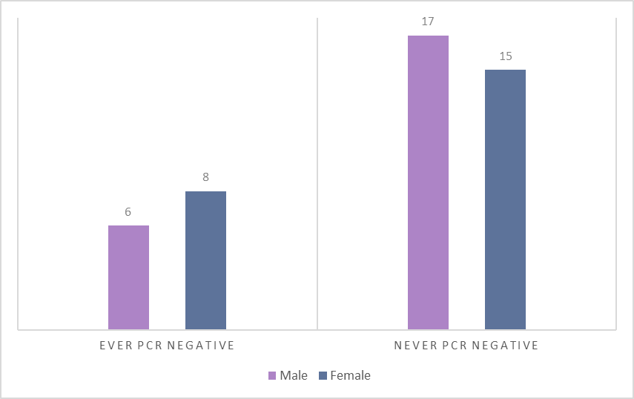
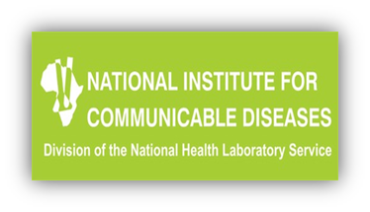
Introduction
Negative diagnostic PCR results among early treated infants in Johannesburg, South Africa
Early initiation of antiretroviral treatment, sometimes within first days of life, is encouraged in perinatally infected neonates.
This early initiation of antiretroviral treatment in neonates may lead to smaller HIV reservoirs.
Successful antiretroviral treatment is able to maintain viral load suppression however antiretroviral treatment is unable to clear the HIV infection.
Intact HIV DNA remains within latent cells despite effective antiretroviral treatment thus leading to the inability to eliminate the virus completely.
Diagnostic PCR tests, which detect total HIV nucleic acids, have been shown to be excellent biomarkers of the quantity of HIV DNA in peripheral blood when the viral load is undetectable.
We investigated frequency of testing negative on diagnostic PCR tests in early-treated neonates.
We also investigated the infant characteristics that were associated with having negative diagnostic PCR test after attaining virological suppression.
PEB0290
M Burke¹, Y Shen², R Strehlau¹, S Shiau³, EJ Abrams^{4,5,6}, CT Tiemessen⁷ , L Kuhn^{2,4} for the LEOPARD Study Team
¹ Empilweni Services and Research Unit, Rahima Moosa Mother and Child Hospital, Department of Paediatrics and Child Health, Faculty of Health Sciences, University of the Witwatersrand, Johannesburg, South Africa, ² Gertrude H. Sergievsky Center, Vagelos College of Physicians and Surgeons, Columbia University Irving Medical Center, New York, NY, USA, ³ Department of Biostatistics and Epidemiology, Rutgers School of Public Health, Piscataway, NJ, USA, ⁴ Department of Epidemiology, Mailman School of Public Health, Columbia University Irving Medical Center, New York, NY, USA, ⁵ICAP at Columbia University, Mailman School of Public Health, Columbia University Irving Medical Center, New York, NY, USA, ⁶Department of Pediatrics, Vagelos College of Physicians & Surgeons, Columbia University Irving Medical Center, New York, NY, USA, ⁷Centre for HIV and STIs, National Institute for Communicable Diseases, National Health Laboratory Services, and Faculty of Health Sciences, University of the Witwatersrand, Johannesburg, South Africa.
Median Pre-ART CD4+ T-cell percentage
p-value 0.01
Ever PCR negative
48.90 %
Never PCR negative
32.66 %
Figure 1
Figure 2
Gender Distribution of 46 Virologically Suppressed Infants According to Diagnostic PCR Status
Significant Infant Characteristics Associated with Diagnostic PCR Status
Methods
We recruited 73 neonates for the LEOPARD (Latency and Early neOnatal Provision of Anti-Retroviral Drugs) clinical trial.
The trial was conducted at the Empilweni Services and Research Unit based at Rahima Moosa Mother and Child Hospital in Johannesburg, South Africa.
The 73 neonates had confirmed HIV intrauterine infection within <48 hours of life.
Antiretroviral treatment was started within the first 14 days of life.
The initial treatment used was nevirapine with lamivudine and zidovudine. Nevirapine was then substituted with lopinavir-ritonavir once the neonate was >42 weeks post-menstrual age and >14 days of life.
Infants were followed up closely whilst on antiretroviral treatment with repeat viral load testing at 1, 2 and 4 weeks of age, every 4 weeks to 24 weeks and then every 8 weeks to 104 weeks.
Diagnostic HIV PCR tests were repeated at 24, 48, 72 and 104 weeks of age.
CD4+ T-cell count and percentage was measured at baseline, 24, 48, 72 and 104 weeks.
Median diagnostic birth PCR cycle threshold (CT)
p-value <0.01
Ever PCR negative
27.8
Never PCR negative
25.6
Table 1
Infant Characteristics and PCR Negative Tests
Infant Characteristics | Total (N=46) | Ever PCR negative (N=14) | Never PCR negative (N=32) | p-value
Age at ART start, N (%) 0 to <= 48 hours >48 hours to 14 days | 29 (63.0) 17 (37.0) | 10 (71.4) 4 (28.6) | 19 (59.4) 13 (40.6) | 0.52
Birth Weight (grams), Median (IQR) | 2,750 (2,425 – 3,180) | 2,673 (2,120 – 3,160) | 2,750 (2,530 – 3,265) | 0.45
Pre-ART HIV RNA (copies/ml), Median (IQR) | 11,908 (901 – 116,138) | 11,910 (901 – 31,445) | 10,725 (910 – 317,660) | 0.75
Results
Of the 61 infants surviving on study, 46 (75.4%) attained viral load <50 copies/mL.
Both males and females were equally represented within the 46 infants who attained viral load suppression.
14/46 (30.4%) who suppressed to <50 copies/mL ever then went on to have a negative diagnostic PCR after antiretroviral start.
6/14 (42.9%) who had a negative diagnostic PCR were male. (Figure 1)
17/32 (53.1%) who never had a negative diagnostic PCR were male. (Figure 1)
The 14 infants who attained virological suppression and had a negative diagnostic PCR on antiretroviral treatment had higher CD4 T-cell percentages pre-ART and higher cycle threshold values on their birth PCR pre-ART. (Figure 2)
Sex, age at antiretroviral treatment start, birthweight, and pre-ART viral load were not significantly different by PCR status. (Table 1)
In 10/14 (71.4%) infants, the last available PCR test on ART was still negative.
Conclusion
Almost a third of infants started on ART within 14 days of life and who suppress test negative on diagnostic PCR tests while remaining on ART.
This proportion is higher than observed in infants starting ART in the first few months of life.
Clinicians should be alerted to these false negative results to avoid unnecessary confusion about the infant’s HIV status.
Acknowledgements
Eunice Kennedy Shriver National Institute of Child Health and Human Development/National Institute of Allergy and Infectious Disease, National Institutes of Health (U01HD080441)
PRESENTED AT THE 23RD INTERNATIONAL AIDS CONFERENCE (AIDS 2020) | 6-10 JULY 2020

